Slide 1
HB 2017 Transit Advisory Committee
April 27, 2018

Slide 2
Meeting Agenda
Welcome and Introductions 5 min.
Public Comment 15 min.
Timeline Discussion 5 min.
Updated Revenue Projections & Apportionment 20 min.
Electric Bus Presentation 30 min.
High Poverty Definition Methodology Discussion 10 min.
Updates: 5 min.
Public Workshops
Regional Coordination Selection Process

Slide 3
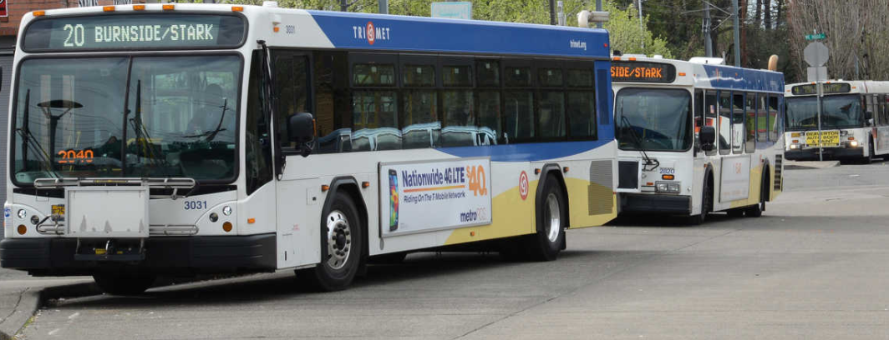
Public Comment

Slide 4
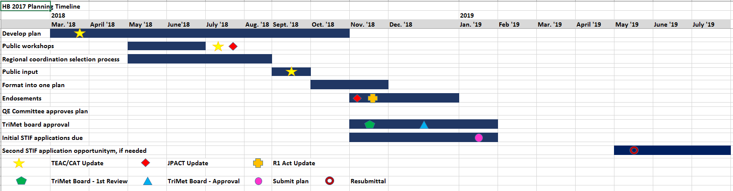
HB2017 Planning Timeline
We are here

Slide 5
Timeline
Questions & Discussion

Slide 6
Updated HB2017 Revenue Estimates
TriMet District Revenue Projections
 | FY19 | FY20 | FY21
ODOT 100% Projection | $18.7 mil | $42.6 mil | $48.2 mil
TriMet Projection (114% of ODOT Projection) | $21.3 mil | $48.6 mil | $55 mil
ODOT 130% Projection | $24.4 mil | $55.5 mil | $62.7 mil
Conservative forecast
Lack of historical data to predict future revenues
Taxpayer compliance is uncertain (assumed at 75%)
Notes:
Estimate Calculation Method
• Gross revenue is multiplied by projected tax payer compliance rate, assumed to begin at 75% and improve each quarter
• Department of Revenue collection and administration costs are deducted from the gross revenue
• The result is multiplied by 90% to determine the projected Formula Fund net total
• Note that the remaining 10% is dedicated to the Discretionary Fund (5%), Intercommunity Discretionary Fund (4%), and the Technical Resource Center (1%), which also funds ODOT administration of STIF Program
• The projected net total is multiplied by the QE payroll shares resulting in QE revenue estimates
• QE payroll shares are calculated using the most current annual payroll data from Oregon Employment Department, with adjustments to ensure each QE receives the minimum annual allocation of $100,000

Slide 7
Updated HB2017 Revenue Estimates
$55 mil
FY21
Contingent Funds
$7.7 mil (14%)
Low Income Fare
$12 mil (22%)
Capital
Purchases
$5.9 mil (11%)
FY19 Service
Proposal $4 mil (7%)
FY20-23 Service Improvements
$21.8 mil (40%)
Regional Coordination
$3 mil (5%)
School Transportation
$550,000 (1%)

Slide 8
Student Transportation
“Each Qualified Entity is required to spend at least one percent of STIF Formula Fund moneys received each year on student transit services for students in grades 9 through 12, if practicable.”
- Draft STIF Rules
There isn’t a definition of what qualifies as a “student transportation” project.

Slide 9
Operations and Capital
Last Meeting
Projected 5 year phase-in of service due to
  Need to hire & train mechanics
  Lack of bus yard capacity
  Purchase of vehicles
Dedicate a percentage of funds to ongoing capital purchases
  Buses
  System capital

Slide 10
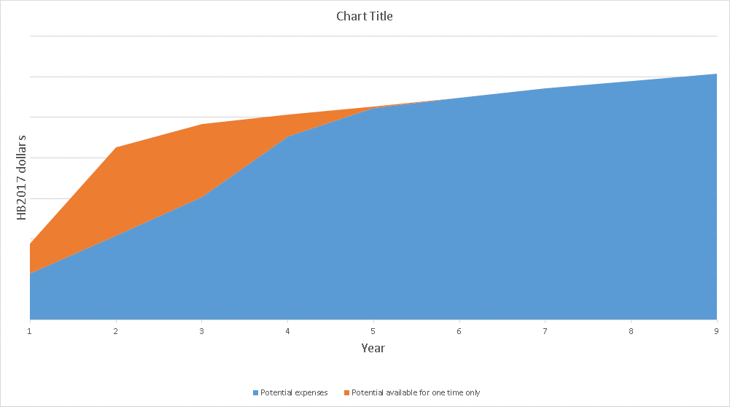
Operations and Capital
Triangle
Funds
Capital Purchases
$17 mil (31%)

Slide 11
Operations and Capital
Recommendation
Triangle funds are only spent on capital projects
  Examples: electric buses & charging infrastructure, articulated buses, bus lanes/transit signal priority, shelters, transit center expansions, etc.
Public workshops and online survey will help to determine how the triangle funds should be spent
Capital Purchases
$17 mil (31%)

Slide 12
Operations and Capital
Questions & Discussion

Slide 13
Electric Bus Presentation
Kate Sargent
Title
Sam Schwartz Transportation Consultants

Slide 14
High Percentage Poverty
Last Meeting
Reviewed several means of viewing poverty
  Various percentages
  Raw numbers
  People per acre
Requests
  Destinations
  Level of service overlay
  Education centers
  Senior and disabled services

Slide 15
High Percentage Poverty
Four step process
Use 10 factor analysis to determine where high concentrations of poverty are located
Determine destinations for high poverty origins
  Employment i.v. Senior and disabled services
  Schools
  Grocery stores
Overlay the existing TriMet network to determine what connections aren’t served or are underserved (discuss transfers)
Any unserved/under served connections will be considered “connections of special concern”

Slide 16
High Percentage Poverty
  10 factor analysis
    People of color Low income population
    Limited English proficiency Senior population
    Youth population People with disabilities
    Limited vehicle access Low & medium wage jobs
    Affordable housing units Key retail/human/social services

Slide 17
High Percentage Poverty
Questions & Discussion

Slide 18
Public Workshops
Updates
4 Workshops (5:30 p.m. to 8:30 p.m.)
  Clackamas County – May 23rd, Milwaukie HS
  North/Northeast Portland – May 24th, SEI
  East Portland/East Multnomah County - June 6th, Ride Connection offices, Gateway
  Washington County – June 7th, Hillsboro Civic Ctr.
IRCO – working with other groups
  Centro Cultural SEI
  POIC Elders in Action
  Ride Connection
  NAYA
Online survey – Launches in early May
General Manager listening sessions

Slide 19
Regional Coordination Selection Process
Appoint Subcommittee
Establish Program Framework, Project Eligibility Requirements & Evaluation Criteria
Project Evaluation & Selection
Incorporate Selected Projects into County Plans
Program Implementation
Project Solicitation Period
HB 2017 Plan Public Comment
HB 2017 Plan Approval
Early August
2019
2018
Updates
April
May
June
July
October
September
1
2
3
4
5
6
Subcommittee Meetings
May 18
Approve Subcommittee Members
June 22
Approve Framework,
Project Eligibility Requirements & Evaluation Criteria
August 24
Approve Selected Projects
& County Plans
TriMet HB2017 Advisory Committee Meetings

Slide 20
Next Meeting: May 18th
Agenda
Results of high poverty analysis
Transit 101 presentation
Early results from the online survey
Public workshops update
Regional coordination selection process update

